Slide 1

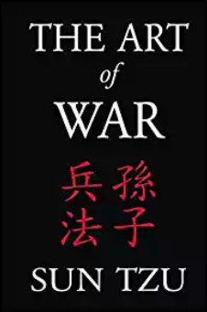
Fundamentals of Electric Transmission System Planning Short Course
The Art of Planning
(or How to Plan Like a Warrior)
Tracy Rolstad
tlrolstad@gmail.com
March 19-21, 2019
Apologies to
Sun Tzu!
© Tracy Rolstad, 2019

Slide 2



Education
Tracy Rolstad
Diploma, Naval War College, College of Naval Command and Staff
BSEE, University of Idaho
Nuclear Navy
Nuclear Operational Prototype (S1C)
Nuclear Power School (Reactor Operator)
Electronics Technician School
Radar, Communications, etc.
Professional Technical Education
Too numerous to list…

Slide 3








Resume…
Trina Solar
Senior Manager Transmission and Interconnection
Grant County PUD
Principal Planner
Power System Consultants
Technical Director
Avista Corporation
Senior Power Systems Consultant
Utility System Efficiencies
Senior Power Systems Analyst
The Bonneville Power Administration
Senior Engineer, System Operations
The Joint Warfare Analysis Center
EP Senior Analyst, PACOM Chief of Targets
Special Technical Operations Action Officer
Nuclear Navy (Attack Submarines)
Chief Petty Officer (ETC/SS)
Engineering Watch Supervisor

Slide 4
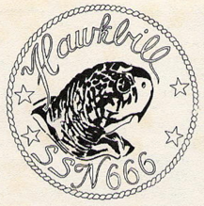
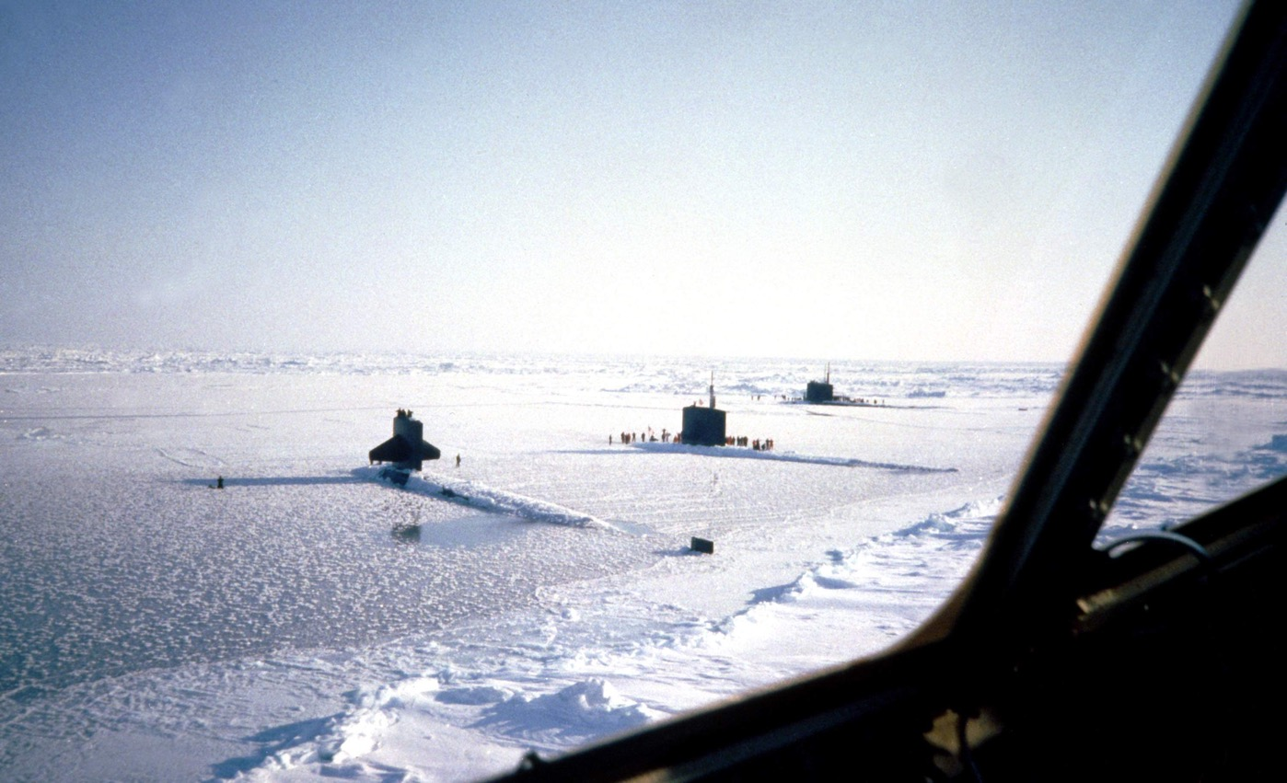
Something Novel About Me

Slide 5
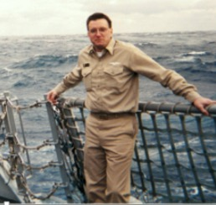
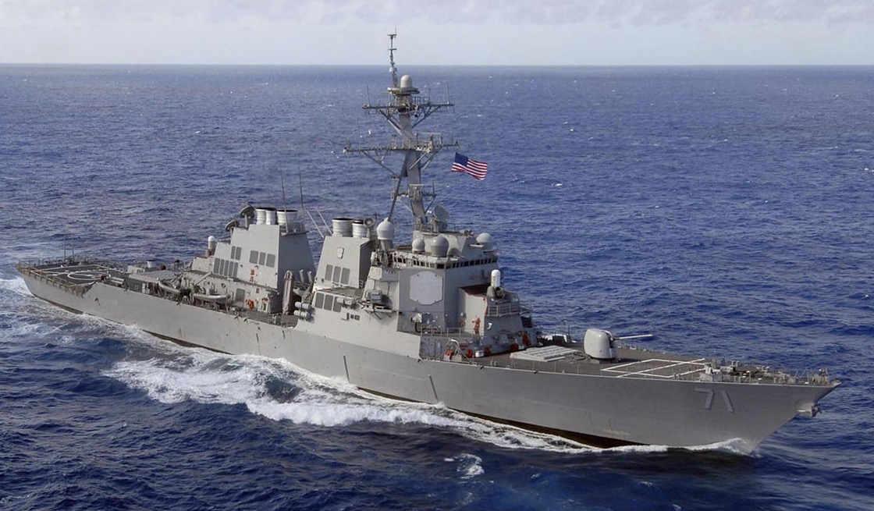
Surface and Submarines

Slide 6
Art of Planning Agenda
Challenge long held beliefs
Gold plating…Ha!
20th Century vs. 21st Century
Electricity as a “right”
Service at end of life must be adequate
Thus, equipment seems oversized to start
But only to the ill informed
Provide conceptual tools to plan for tomorrow!
Vocabulary Matters
We will be talking about words

Slide 7
Our Method
What you get done in three days?
Broad examples that lead you to details
Seminar style of instruction
Participate!
You might be up here clicking on PWS
Ask questions!
We want feedback
We will use various cases
Synthetic cases and snippets of others
Let's think together

Slide 8
Celebrate Your Job!
What is your job ultimately?
As a Planner or Operator that is…
Any role in the power business
Class input

Slide 9
Celebrate Your Job!
What is your job ultimately?
To be boring!
You do NOT wasn’t to be noticed!!!!

Slide 10
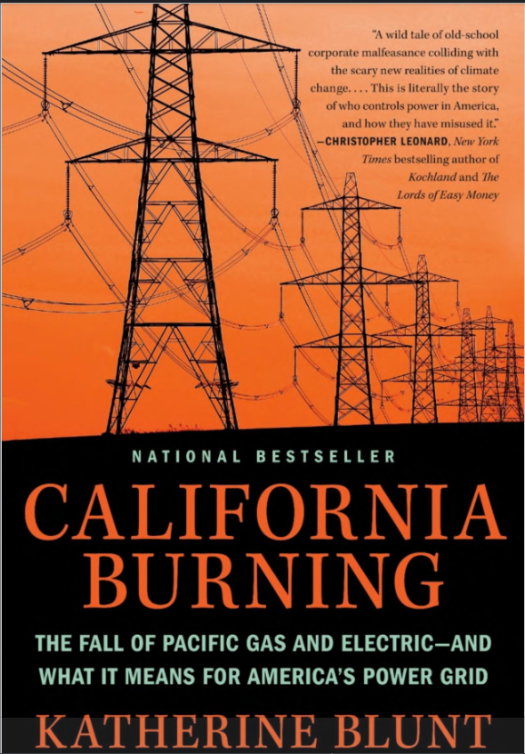
Avoid Being the Subject of Books
Excellent Book
Fair and factual

Slide 11
Celebrate Your Job!
What is your job ultimately?
To be boring!
Defeat the “enemy”
Who is the enemy?
Poor or unreliable service (outages)
Or being the subject of a book!
We provide a commodity (electricity)
Virtually indistinguishable from “competitors”
Except for price
Be safe, reliable, affordable…
If you know the enemy and you know yourself, your victory will not stand in doubt ~ Sun Tzu

Slide 12

Boring…but the Greatest!

Slide 13
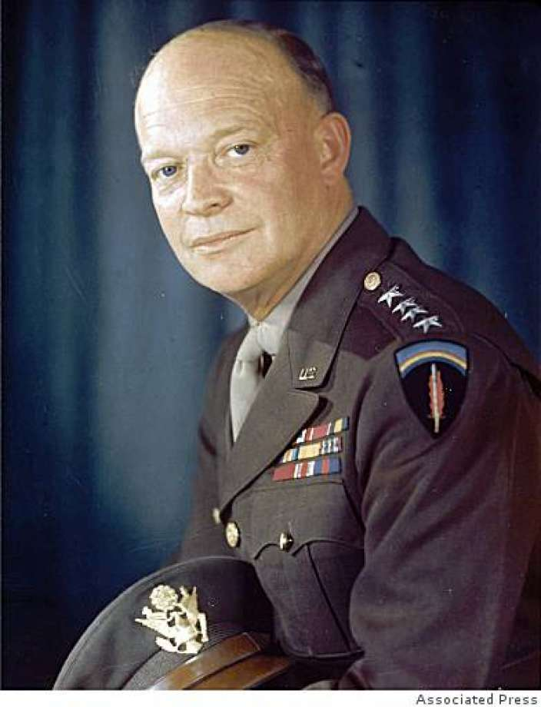
Eisenhower
Plans are nothing, planning is everything
Who taught Eisenhower?

Slide 14
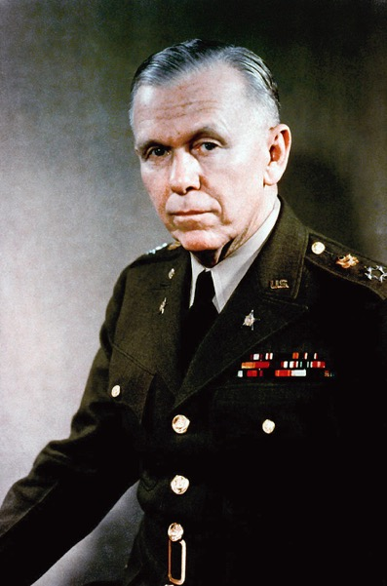
Marshall
Don’t fight the problem. Decide it!
I don't want you fellows sitting around asking me what to do. I want you to tell me what to do. This is what Planners tell CEO’s…what to do.

Slide 15
The Best and Simplest Plan Is?
Thoughts?

Slide 16
The Best and Simplest Plan Is?
Thoughts?
Site generation next to load
Do this and we can just stop talking right now
It IS happening!
And, it isn’t
People don’t live where the wind blows
Utility scale solar needs land

Slide 17
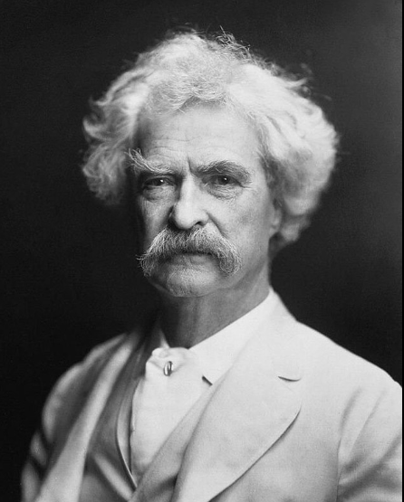
Planning Precepts
Always look at
Status Quo
Likely performs poorly
Direct Approach
Reconductor/Rebuild existing
Alternative Approach
New voltage, new line, new station,etc
"Buy land, they're not making it anymore"

Slide 18
Planning
Two Kinds
Operations Planning
Near term (<12 months)
You got what you got
Switches, breakers, limits, and redispatch are the tools
Think NERC EOP and TOP standards
Long Term Planning
> 12 months…Planning for the long haul
Not even remotely the same viewpoints as Ops Planning
Except for technical performance under outages
Money Matters!
Service Life Matters!
First Cost vs Holistic Life Cycle Cost
What IS your amortization period
Don’t be cheap!

Slide 19
Who Do You Work For?
Where does your $
come from?
Investor-Owned Utility
ROI on Capital (~60/40 equity/debt)
Muni/City/State/Coop/PUD/REA
Bonds…debt…federal loans
Power Marketing Agency (Federal)
Borrow from the US Treasury
ISO
Owns nothing, “operates” everything
RTO
Owns nothing, “coordinates” everything

Slide 20
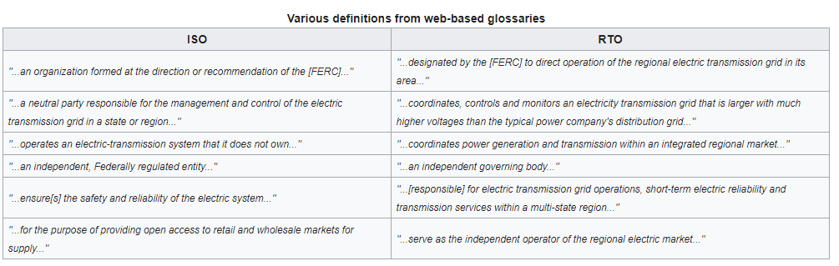
ISO vs RTO
Go Wikipedia! Texas, of course, is different

Slide 21
Social Compact
Electric utilities:
Operate state granted monopolies (electricity or gas)
Regulated by state utility commissions.
Invest equity in large capital-intensive equipment (mostly generators)
Earn a return on their equity investment.
Franchise service territory
No true competition historically speaking
Competitive forces are regulatory in nature
The business model has been “invest in equipment, turn the customers’ meters, and earn a steady profit.”
Past tense!
Stocks for Widows and Orphans
Utilities are no longer considered a “safe harbor”

Slide 22
Prudency (The Federal Viewpoint)

Slide 23
Investor Owned Utilities
The Three Pillars
Corporation
Mostly Employees is what we are talking about
The “Stewards”
Share holders
Up fronted the capital
Shares (equity)
And “guarantee” loan repayments
Ratepayers (i.e. customers)
Pay for it all
Safeguarded by elected officials and regulators
Always a commission somewhere

Slide 24
Sunk Costs (or…It’s in Rates)
A sunk cost is a cost that has already been incurred and cannot be recovered.
Mistakes get buried
A sunk cost differs from future costs that a business may face, such as decisions about inventory purchase costs or product pricing.
Sunk costs (past costs) are excluded from future business decisions because the cost will be the same regardless of the outcome of a decision.
Again, mistakes can get buried
This is why someone reviews decisions

Slide 25

Art of Planning Talking Points
Know yourself, know your “enemy”
Understand the philosophy
If you disagree
Change it
Move on
Be charming and persuasive
Modify plans at any time
Employ only the capable
Never fall in love with your plans
Why not the best?
And better is the enemy of good enough

Slide 26

Know Yourself & Know Your ”Enemy”
We are heavily regulated
Do you know the rules that apply to you?
We just saw what prudency was
Defined at the federal level
Federal
FERC and indirectly NERC
State(s)
Commission, ISO, RTO
Local
Franchise service area, etc.
This lovely child crushed
the federal government
Click the Pic!

Slide 27
Charming and Persuasive
You decide!
BPA PM looks ill…poor Mark

Slide 28
The Real Enemy (bye bye PDCI)

Slide 29
Federal Energy Regulatory Commission
Empowered by the Congress (We, the People)
Until 2005 mostly commercial focus
Interstate commerce clause
What happened in 2005?
It actually happened in 2003…

Slide 30
Federal Energy Regulatory Commission
Empowered by the Congress (We, the People)
Until 2005 mostly commercial focus
Interstate commerce clause
What happened in 2005?
It actually started in 2003…
Energy Policy Act of 2005
Mandatory Reliability Standards
Via NERC

Slide 31
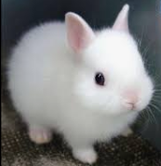
A Rabbit Hole for Deep Background
Credits to Chris Lum (former colleague) for these slides on NERC

Slide 32
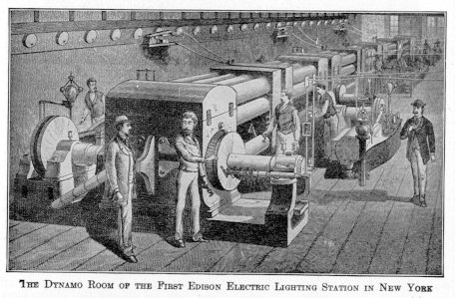
The Race to Illumination
The war of the electric currents
-Edison’s proposed DC system (Pearl Street Station) 110V
-Tesla’s AC System the bid for 1893 World Fair in Chicago
-The Niagara Falls Power Project
Tesla’s AC system won in the end
-The ability for off-site generation
-The ability to change voltage levels
-DC was not as flexible
Notes:
Edison’s DC had the head start, until the creation of the AC motor, and Transformer. DC plant operated at 110VDC. Sites needed to be close to load centers. AC pushed ahead due to the ability for off site generation, and the flexibility of voltage operating ranges. Energy could be generated at one voltage, stepped up to reduce the line current, sent to another location, and reduced to another operating voltage at the load. DC did not have this ability.

Slide 33
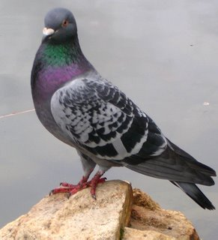
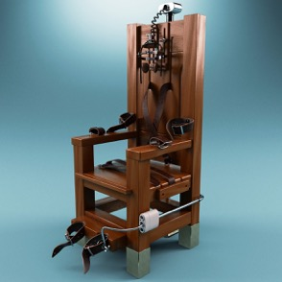
The War of Weird Things…and People
Tesla was an interesting character
He loved pigeons
He had some interesting practices
An interesting invention came out of this “war”
Edison’s public demonstration of AC led to The Electric Chair
The term “Westinghoused”

Slide 34
A Time Line
The Early 1900’s
Mid 1900’s
1960+
Small AC and DC systems were constructed in dense areas
By 1920’s, nearly every city had a single utility.
FPC formed in 1920’s
Vertical Integration
By 1940 all states formed regulatory commissions
Utilities begin to interconnect systems in regions
Larger generation requirements led to new power plants
Electrification of rural areas
Fast expansion of “the grid”
Region-Region links begin
Midwest integrates into a single inter-regional grid
H.E Power on the Columbia River and elsewhere drive network development in the West
No reliability controls to speak of
Notes:
Expansion of the grid really took off from WWI through the mid 60’s. Due to massive growth, power companies could barely build generation sites and transmission fast enough to meet the load requirements. Into the 60’s, the grid was operating at near capacity, with often little reserves available. It was only a matter of time before there was a malfunction on a power system.

Slide 35
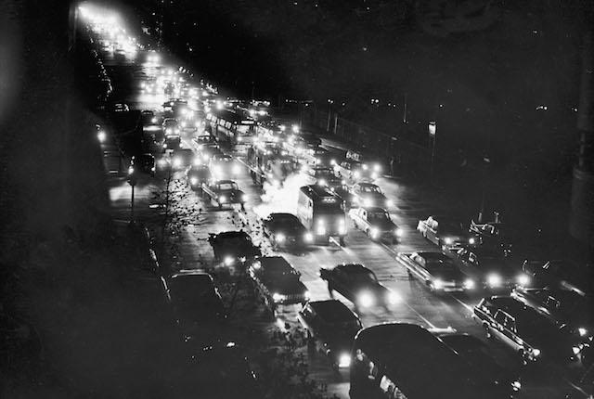
The “Reliability” Crisis
A rather unanticipated risk of large power networks was the likelihood of a large-scaled outage dramatically increased
By the late 1960’s the system was operating near capacity
The Great Northeast Blackout of 1965 put the spotlight on the issue of reliability
One minor equipment failure had a domino effect on the entire system
30 million people out of power
Notes:
1.)The assumption was that because the system was interconnected on such a large scale, it was essentially black-out proof.
2.) The twenty-three member companies operating the grid (CANUSE) were still convinced that the system was built to adequate reliability standards due to the fact that they out entire power plants out of service for maintenance without any disruption in power service. In the outage of 1965, the built-in backup was built far beyond

Slide 36
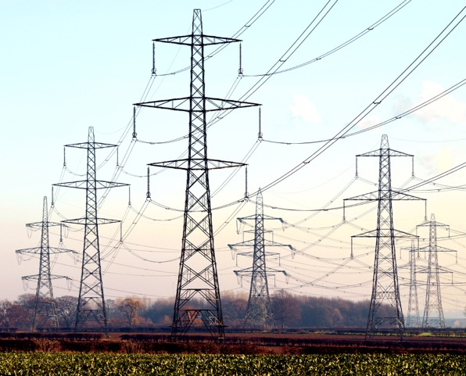
The “Reliability” Solution
Following the 1965 blackout, there was a large backlash on utilities
Customer outcry
People began to question dependency on large power systems
Worried about the prospect of govt. regulation, utilities founded the National Electric Reliability Corporation (NERC)
And the various Coordinating Councils
LBJ was very powerful
Fix it said, or I will…
The Feds had to fix it after all
2007 NERC stds in play
Mandatory
Notes:
U.S. Electric Power Reliability Act of 1967 proposes the creation of a council on power coordination. Although not enacted, the proposed legislation was what really drove the creation of NAERC.

Slide 37
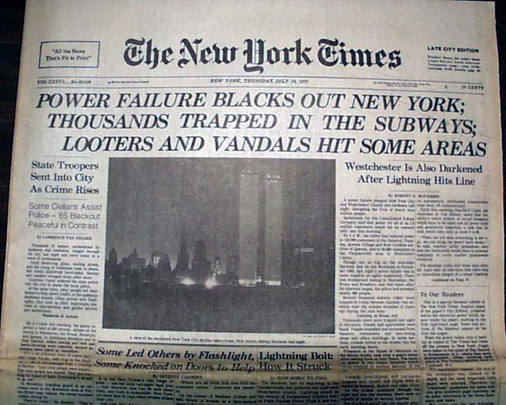
The 40-Year Fallout
NERC Implements voluntary agreements to fine utility companies
1977 New York Blackout Occurs
Limited reliability legislation ensues, allowing voluntary agreement to standards
Realization that power outages have effects beyond the lights not turning on
Notes:
-9 regional reliability organizations formalized
-Voluntary operating and coordinating guidelines are implemented

Slide 38
The 40-Year Fallout
1977 Outage
1996 Outage
2003 Outage
New York City blackout occurs
Leads to first limited reliability provision in Fed. Govt.
Enables Govt. to propose voluntary standards
Two major blackouts in Western U.S.
WSCC develops Reliability Standards System
Member utilities voluntarily agree to pay fines to WSCC for reliability Violations
Still no Federal Regulation
Worst blackout to date in U.S. occurs
Task force is put together to investigate outage
Final report concludes that to prevent future blackouts, govt. needs mandatory reliability standards.
You had your chance!
Notes:
Western Systems Coordinating Council

Slide 39
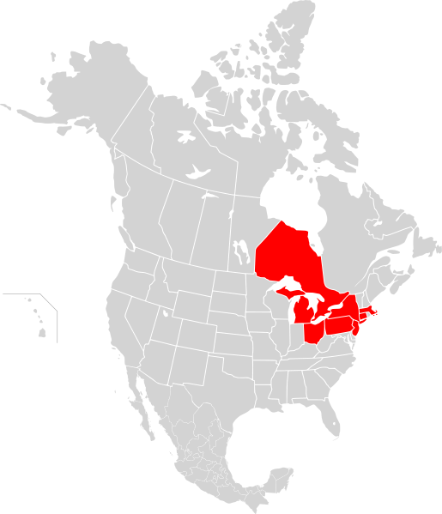
This Was Totally Avoidable!
Northeast Blackout of 2003
10 Million people in Ontario, Canada
45 million people in eight U.S. states
Hubris is not attractive
Bunnies are though!

Slide 40
Mandatory Reliability Standards
2006 – NERC Files an application with FERC to become ERO in U.S.
2007 – NERC has been certified by FERC and reliability standards become mandatory for all Utilities
Version 0 Reliability Standards
In 2004, NERC begins translating it’s operating policies in to 90 measurable standards
Energy Policy Act of 2005
Authorizes the creation of a Electric Reliability Organization w/ oversight from NERC

Slide 41

Summary on NERC Standards
Studies
Federal Regulation was ultimately due to utilities not getting it done on their own
Do!

Slide 42
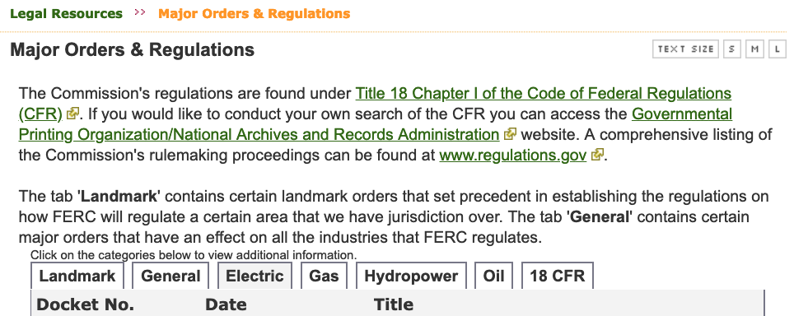
FERC Landmark Orders
It is literally a thing!
https://www.ferc.gov/legal/maj-ord-reg.asp?csrt=16665937672332480749

Slide 43
Some Notable FERC Events
1977
DOE Organization Act
Forms DOE
FPC becomes FERC
PMA’s leave Interior
WAPA formed
Bureau lost transmission
1978
Public Utilities Regulatory Policies Act (PURPA)
Allows NUG’s to plug in (avoided cost rates)
This is ground breaking
But not overly effective
1996
Order 888
Why was 888 chosen?
Open Access!
OATT’s come from 890
Order 889 (OASIS)
1999
Order 2000
Facilitates RTO Formation
2000
Order 638
Standards of Conduct
2003
Order 2003
Standardizes LGIA
Order 2006 for SGIA
2005
Order 661 (Wind is different)
2007
Order 667 repeals PUHCA
Order 693
Mandatory Reliability Standards
Order 697
Market Power Studies

Slide 44
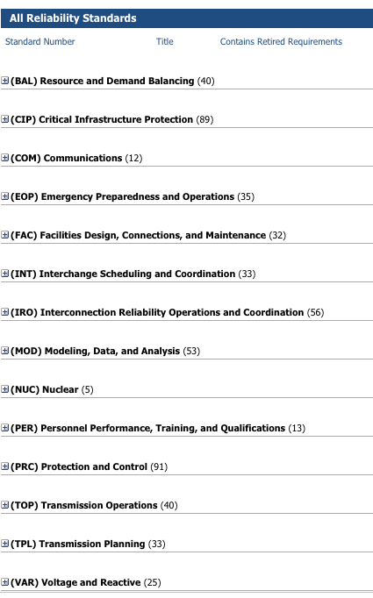

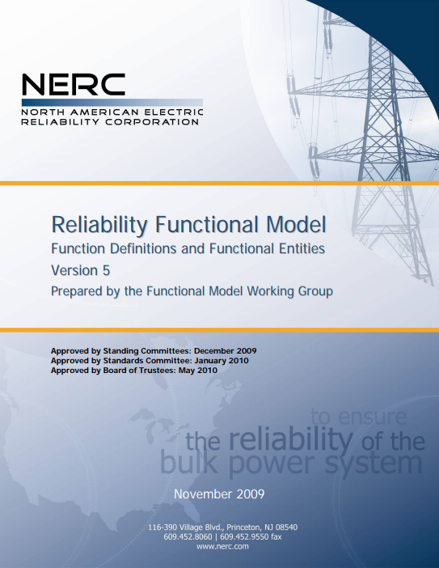
Order 693 and NERC Reliability Standards

Slide 45
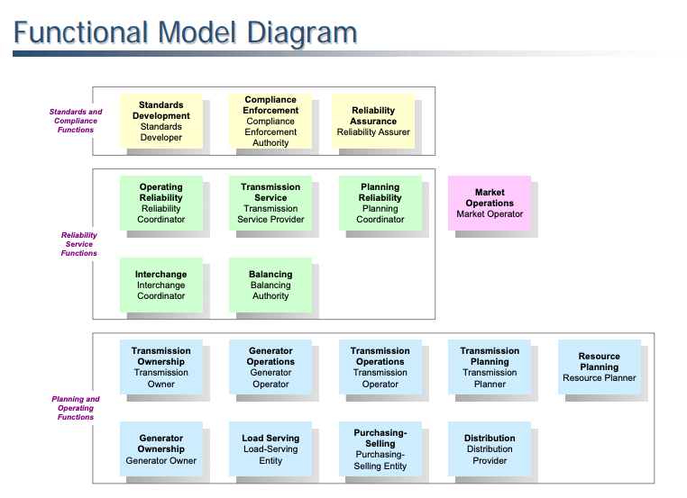
Know Yourself

Slide 46
Employ Only the Capable
People, Parts, Processes, and Programs
People: Planning should be the pinnacle of a career
Sadly, it has trended towards being a starting place
This course is here to help!
Parts: Think for the long haul
Uncertainty rules
Processes: Write it down!
The NERC Compliance Machine needs to be fed
Documentation is the hallmark of Professionalism
Programs: Software
We are fans of PWS!

Slide 47
Capable People
Electrical Engineers with Power Emphasis
Lets hope your employer values you
The Electrical Engineering is easy
Knowing the battle field is not!
This course is designed to help you perform ”IPB”
Intelligence Preparation of the Battlefield

Slide 48
Capable Parts
Why not the Best
Jimmy Carter’s Book
Heavily influenced by Hyman Rickover
Better is the Enemy of Good Enough?
The “Gold plating” view of the 20th century
You know, those people that thought blackouts every 5 to 10 years was ok

Slide 49
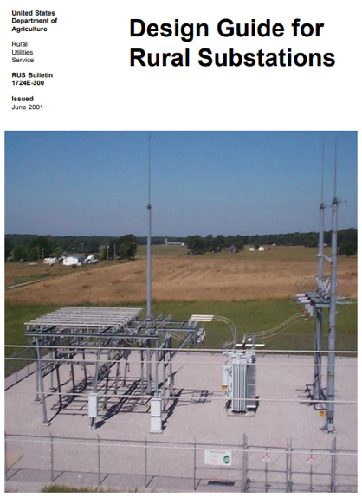
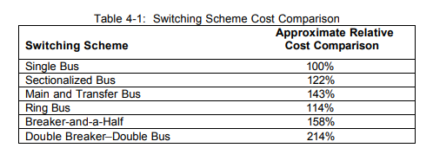
Capable Parts: Station Designs
Single Bus—Single Breaker
Main and Transfer Bus (Main and Aux bus)
Ring Bus
Breaker and a half
Double Bus—Double Breaker
Why or why would you build Main and Transfer?

Slide 50
Capable Parts: Station Designs
System Performance Matters
NERC Standards (TPL-001-4)
Probability is not really an option
Breakers are good! More is better…really
Never mind the inside the station (i.e. breaker statistics) performance
It’s the outside the station performance that matters
Specify facility limits for the long haul
Buy good stuff…plan for growth…plan for higher voltages
PLAN FOR HIGHER TEMPERATURES!!!
Stop with 30C ratings!!!
50C is actually the proper design specification
Don’t use “magic wind” unless you can empirically support it’s use
FERC Order 881…

Slide 51
Capable Parts: Conductor Material
Material | Resistivity | Conductivity
 | ρ (Ω·m) at 20 °C | σ (S/m) at 20 °C
Silver | 1.59×10⁻⁸ | 6.30×10⁷
Copper | 1.68×10⁻⁸ | 5.96×10⁷
Gold | 2.44×10⁻⁸ | 4.1×10⁷
Aluminum | 2.65×10⁻⁸ | 3.77×10⁷
Calcium | 3.36×10⁻⁸ | 2.98×10⁷
Tungsten | 5.60×10⁻⁸ | 1.79×10⁷
Zinc | 5.90×10⁻⁸ | 1.69×10⁷
Nickel | 6.99×10⁻⁸ | 1.43×10⁷
Iron | 9.7×10⁻⁸ | 1×10⁷
Platinum | 1.06×10⁻⁷ | 9.43×10⁶
Tin | 1.09×10⁻⁷ | 9.17×10⁶
Carbon steel (1010) | 1.43×10⁻⁷ | 6.99×10⁶
Lead | 2.20×10⁻⁷ | 4.55×10⁶
Titanium | 4.20×10⁻⁷ | 2.38×10⁶
Stainless steel | 6.90×10⁻⁷ | 1.45×10⁶
Carbon (amorphous) | 5×10⁻⁴ to 8×10⁻⁴ | 1.25×10³ to 2×10³
Sea water | 2.00×10⁻¹ | 4.8
Drinking water | 2×10¹ to 2×10³ | 5×10⁻⁴ to 5×10⁻²
Silicon | 6.4×10² | 1.56×10⁻³
Wood (damp) | 1×10³ to 1×10⁴ | 10⁻⁴ to 10⁻³
Deionized water | 1.80×10⁵ | 5.50×10⁻⁶
Glass | 1×10¹¹ to 1×10¹⁵ | 10⁻¹⁵ to 10⁻¹¹
Carbon (diamond) | 1×10¹² | ~10⁻¹³
Hard rubber | 1×10¹³ | 10⁻¹⁴
Air | 10⁹ to 10¹⁵ | ~10⁻¹⁵ to 10⁻⁹
Wood (oven dry) | 1×10¹⁴ to 1×10¹⁶ | 10⁻¹⁶ to 10⁻¹⁴
Teflon | 1×10²³ to 1×10²⁵ | 10⁻²⁵ to 10⁻²³
Silver
The best
Lots of free e⁻
Copper
The practical start
Gold
$$$$
Aluminum
Why Al?
Steel
Strong but rusty

Slide 52
Capable Parts: Aluminum Wire
Why Aluminum?
Third most abundant element on the planet (O2 & Si)
Ironically it took electrification to make it extractable
It is lightweight
This matters
Self passivating surface
Aluminum Oxide is an insulator
But so thin we don’t care
Pay by the pound
Don’t be cheap
If you want long life
Under N-1-1 conditions
Or more…
Pounds Per Cubic Foot
Aluminum 168.48
Zinc 445.30
Steel, Cast/Rolled 490.00
Iron 491.09
Copper 559.87
Silver 654.91
Gold 1206.83
Platinum 1339.20

Slide 53
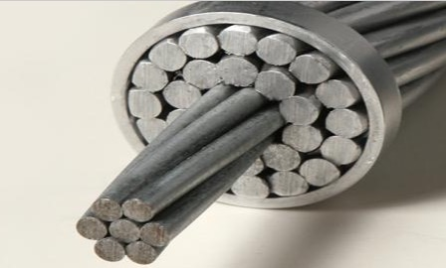
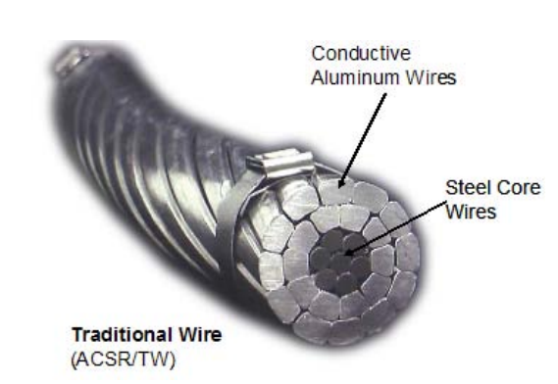
Capable Parts: ACSR/AACC/ACSS
All things Aluminum
ACSR
Birds
ACSR/TW
NW Rivers
Why?
Transmission lasts >100 years…it should perform adequately at amortized EOL.
Go big or go home!

Slide 54
Capable Programs: Shout to Bill Tinney
BPA Great
IPF Software
PECO
PSS/e
PSLF
Power Factory
NEPLAN
PowerWorld Simulator
We will be using this
Power flows…load does not
Words matter: Reactive Power sure isn’t Imaginary
Want to try passing 1000 Amps of reactive current through yourself? Let's refer to it as reactive power thanks…

Slide 55
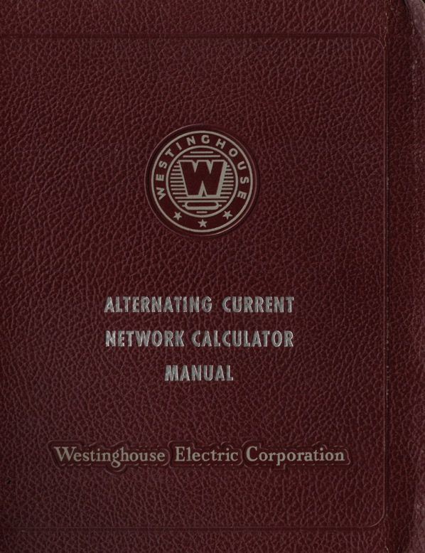
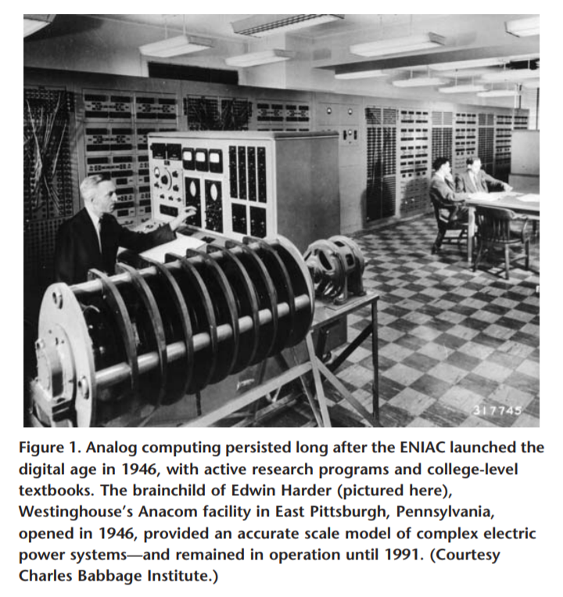
Capable Programs: The Past

Slide 56
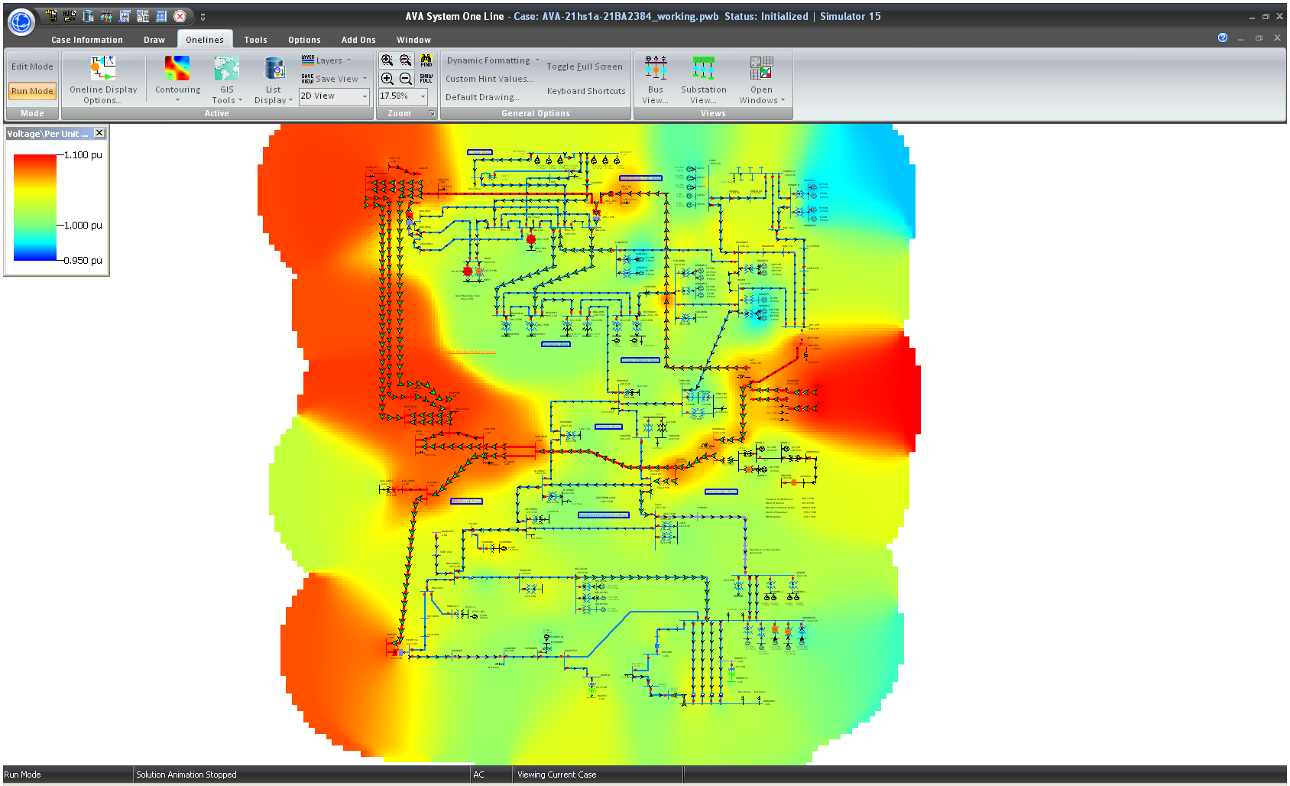
What we will use…

Slide 57

Oh, the Studies You’ll Do
Studies
Do!
NERC Compliance
FERC Compliance
GUP
What is GUP?

Slide 58
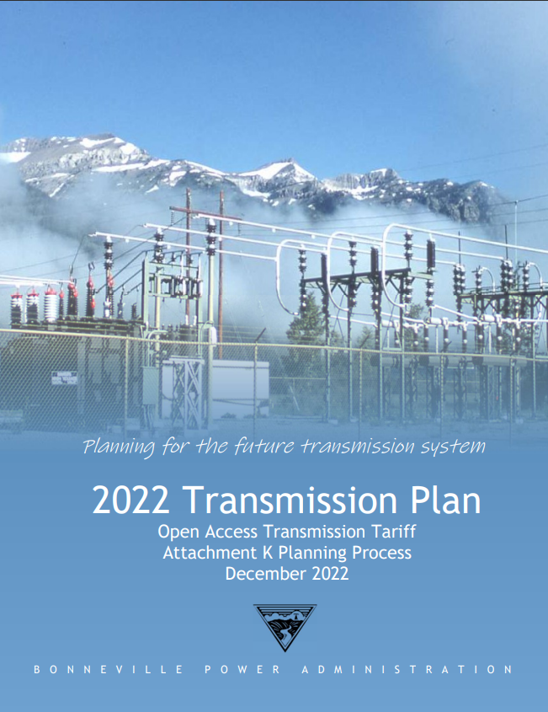
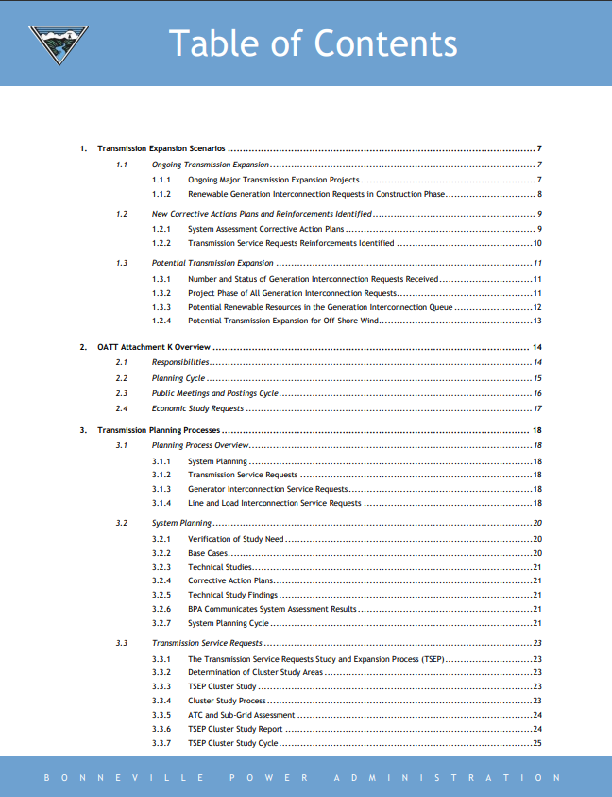
Good examples abound (look at OASIS)

Slide 59

Questions?

